Slide 1
Comparison of versions
First version – updated with sensitivities, using implementation based on submitted NCC version
Second version – used in NPJ Climate Action paper
Third version – small updates, no large changes on projections (only a few pixels)

Slide 2
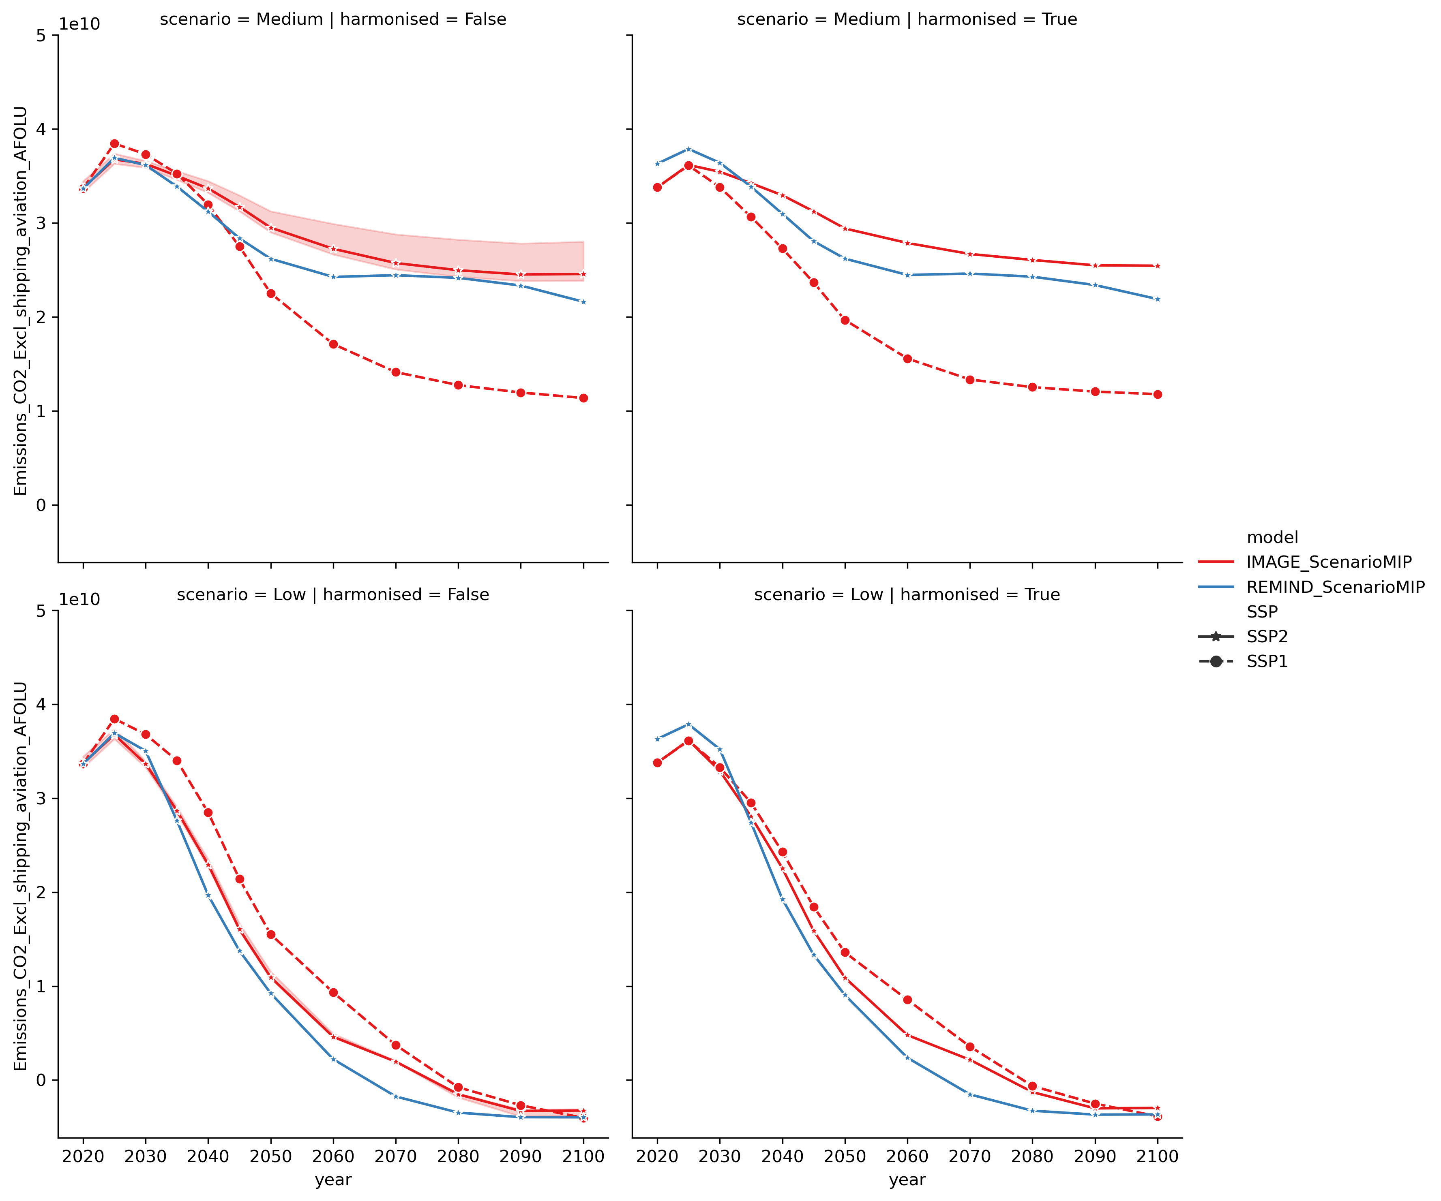
First version (NCC)

Slide 3
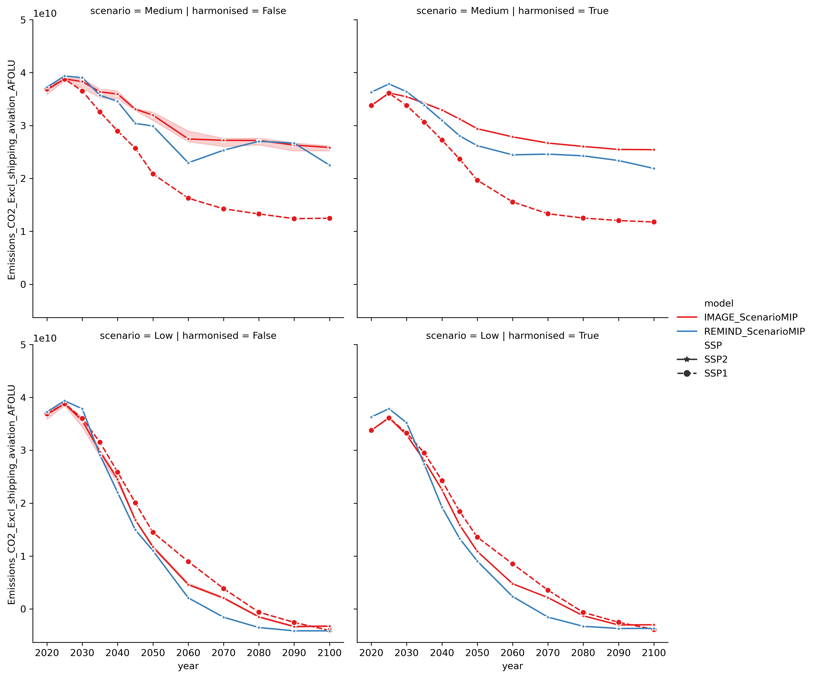
Second version
(NPJ climate action)

Slide 4
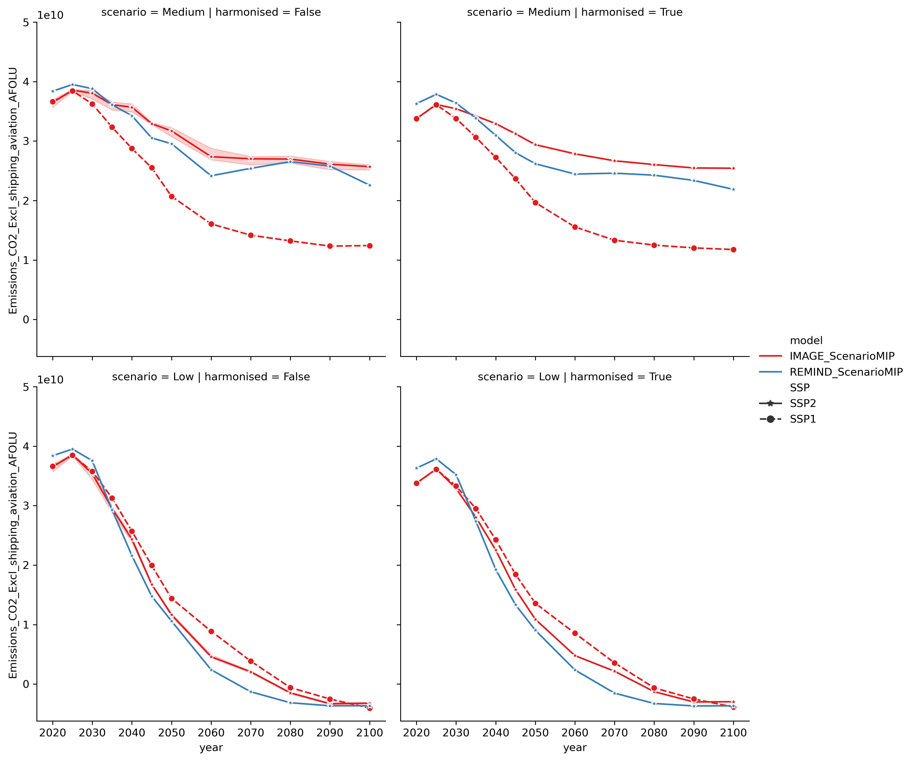
Third version
(update)

Slide 5
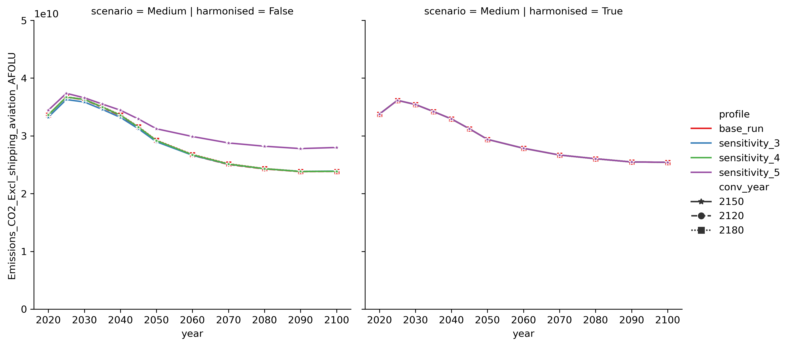
First version

Slide 6
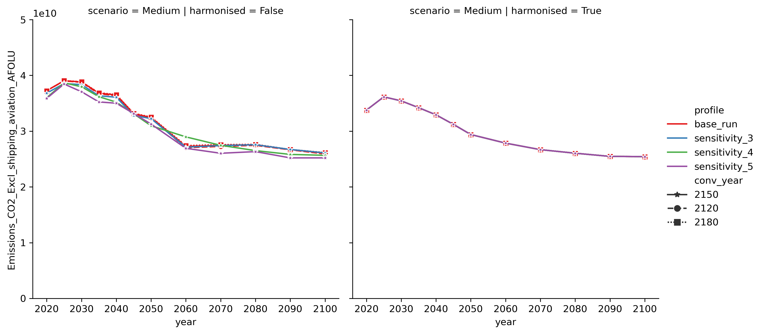
Second version

Slide 7
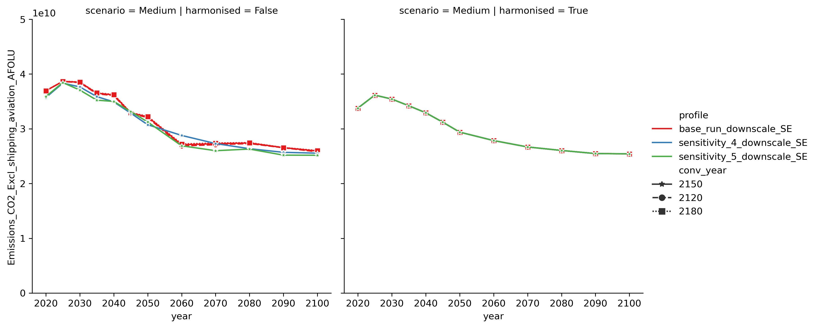
Third version

Slide 8
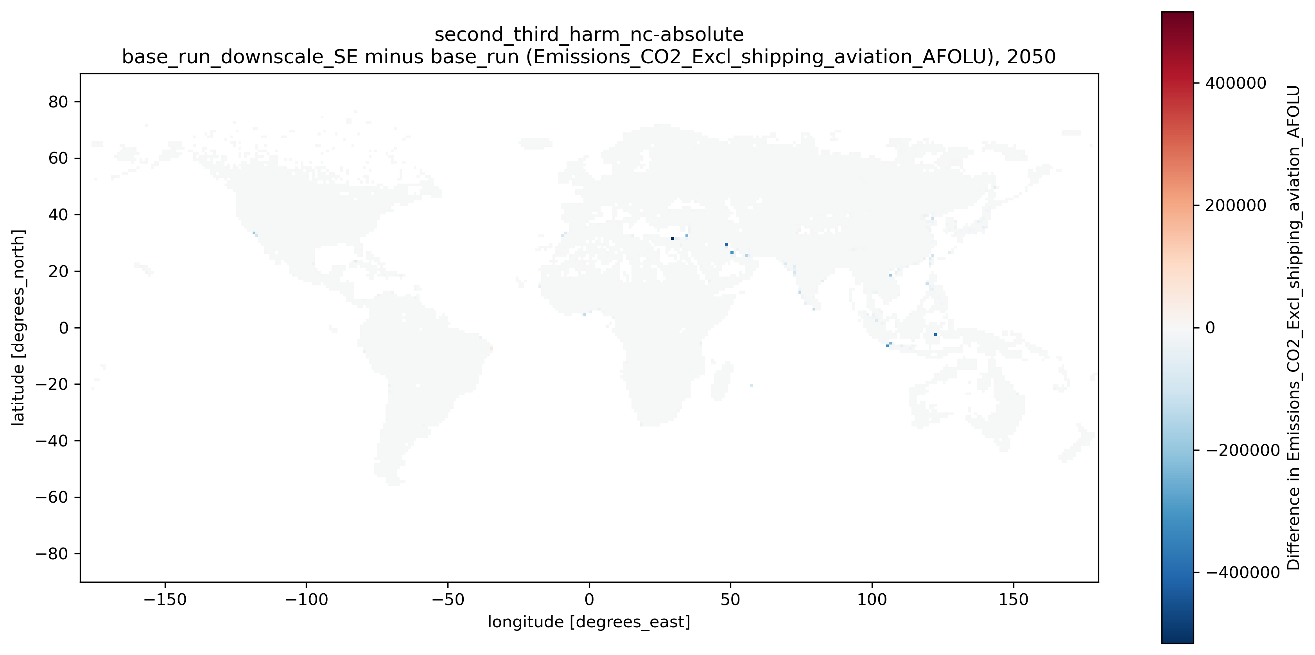
Difference Second/Third version (absolute)

Slide 9
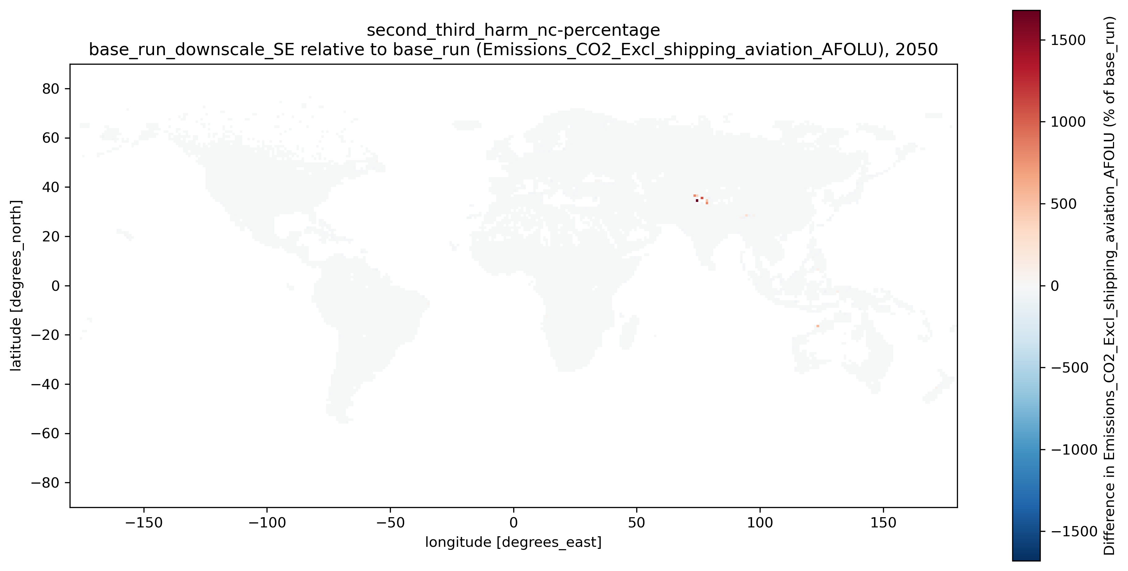
Difference Second/Third version (percentage)

Slide 10
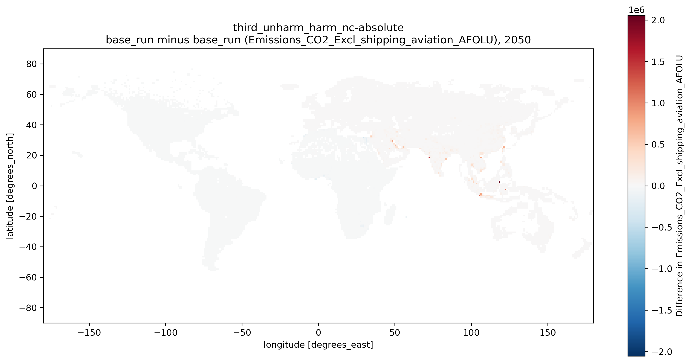
Difference unharmonized/harmonized (Third version, absolute)

Slide 11
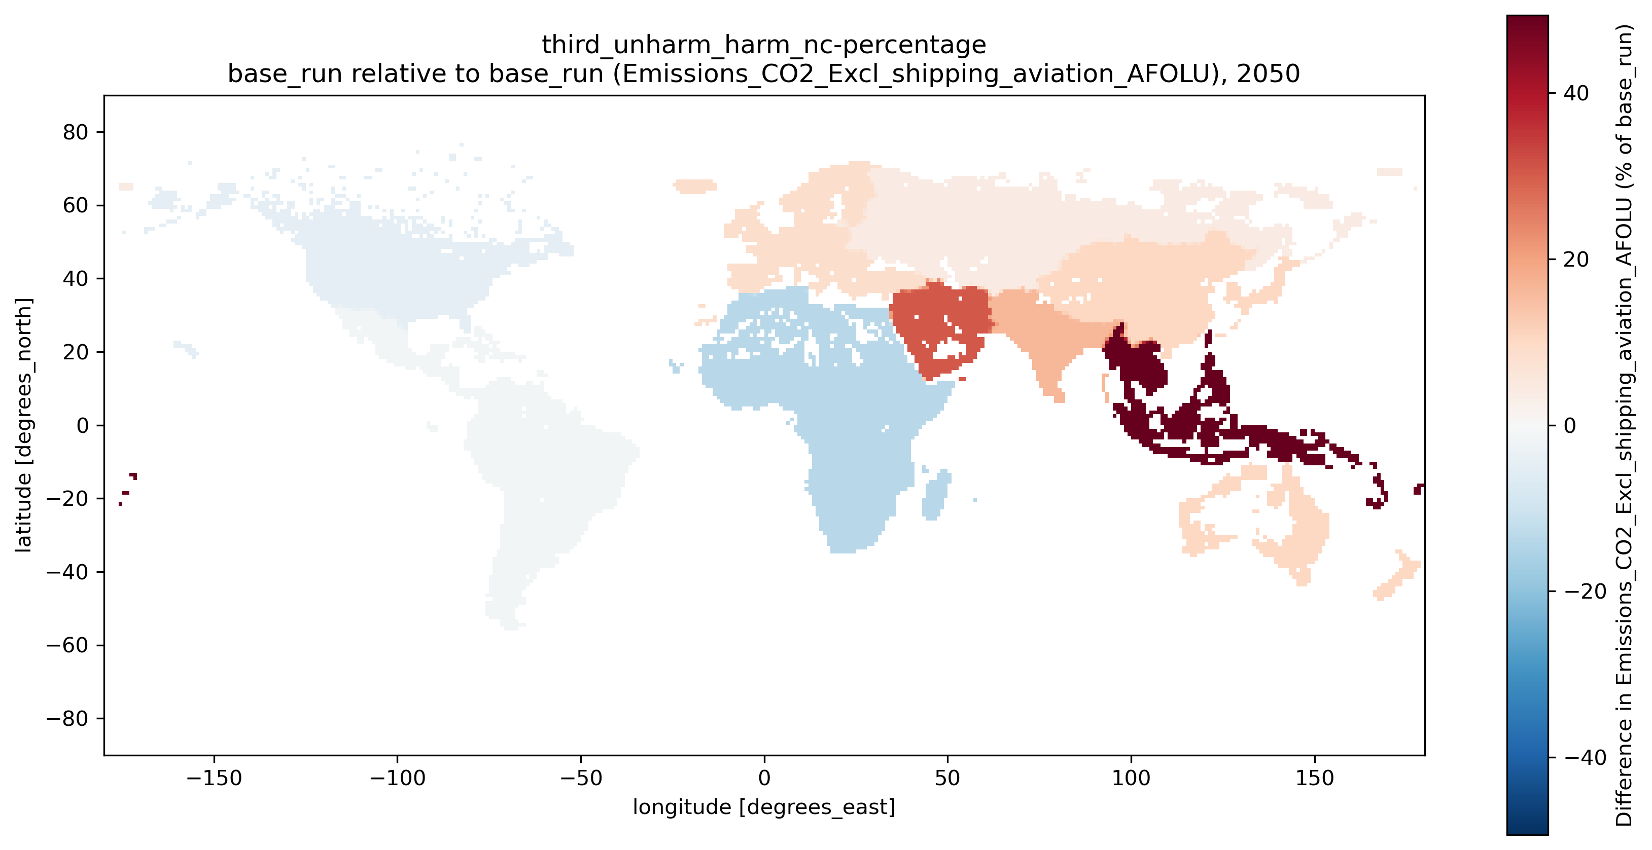
Difference unharmonized/harmonized (Third version, percentage)

